Slide 1
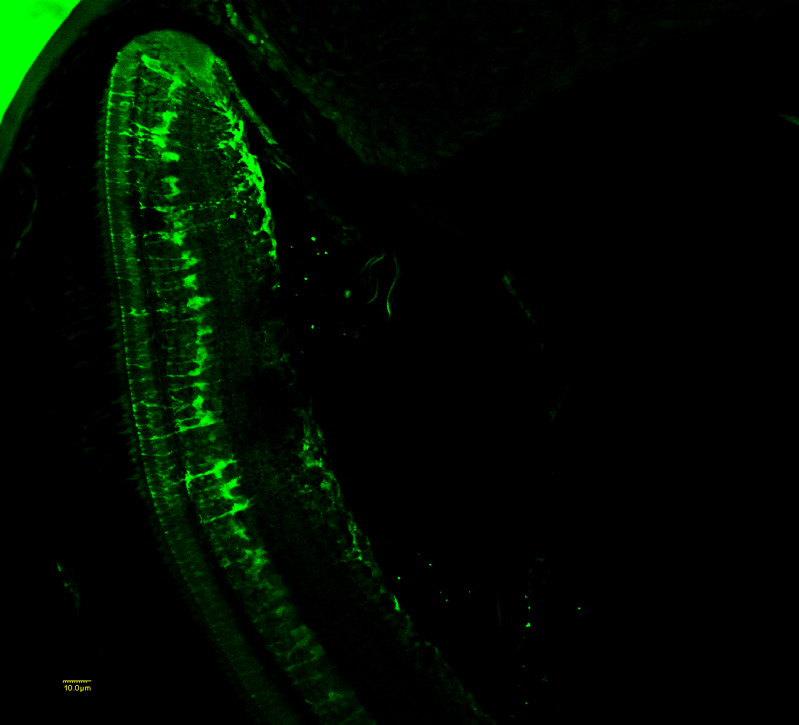
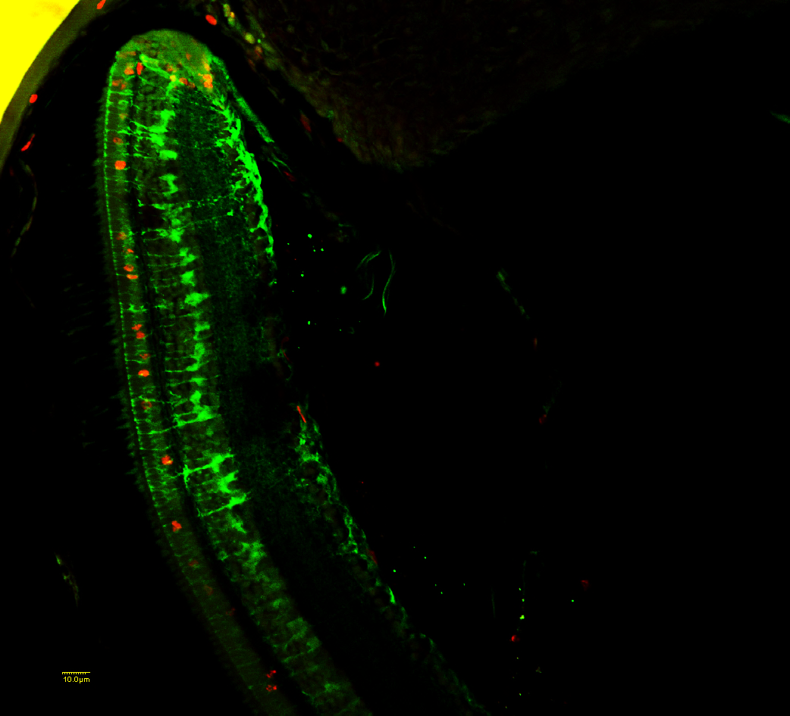
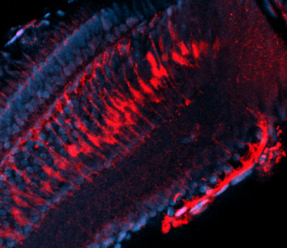
Figure 6
A
BrdU
CMZ
B
BLBP
ONL
INL
*
GCL
C
BLBP- BrdU
1
*
DAPI-BLBP
2
3

